Slide 1
TDEM STATEWIDE EXERCISE SEPTEMBER 23—25, 2022

Slide 2
This Statewide Exercise includes members of both ARES and RACES.
Guidance and direction of the exercise is provided by the RACES Regional Radio Officers, District Radio Officers and County Liaison Officers and the ARES Section Emergency Coordinator, District Emergency Coordinators and County Emergency Coordinators working in concert with their counterparts in the following guidance and reporting requirements provided herein.

Slide 3
RACES CLO’S and ARES EC’s are critical to the success of this Statewide Exercise. They are responsible for ensuring their groups know what to do and when to do it.
Their responsibility includes ensuring that all RACES and/or ARES members provide the required information in the formats requested.
The following slides provide the tasks to be accomplished.

Slide 4
ARES and RACES TASKS
RACES CLO and ARES EC establishes a net at a specific time and date on a local repeater frequency (their choice).
To meet other task requirements we suggest this be on Friday evening September 23 or Saturday morning September 24.
RACES and ARES members will check-in providing the following information in the requested format:

Slide 5
EXERCISE TASKS
STEP ONE
Operators should follow their district exercise voice and digital radio plans. As determined by their RACES CLO and/or ARES EC.
Operators are asked to compose a voice radio message using a ICS Form 213 that includes the following information.
Using Google Earth or a paper map, determine which of the following facilities are within a two-mile radius of your location.

Slide 6
1. School(s) – Number.
2. Hospital(s) – Number.
3. Power Plant(s) – Number.
4. Water Treatment Plant(s) – Number.
5. Storm Shelter(s) – Number.
Using your prepared ICS-213, transmit the
collected information to Net Control:

Slide 7
EXERCISE TASK
STEP TWO
Compose a Winlink Check-In Form, this form is found in Templates under Standard Forms, Mapping-GIS forms. Include the above requested information in your Winlink message.
Input your GPS coordinates and grid square information into the Winlink Check-in form. The form has instructions to accomplish this task.
Prepare and send a P2P message via UHF, or VHF, or HF to your RACES CLO or ARES EC on their designated frequency.
If RACES or ARES members do not have HF capability they may submit their Winlink message using Winlink Telnet

Slide 9
RACES CLO’s and ARES EC’s will then transmit the information received to their DRO or DEC using Winlink P2P. Contact your DRO or DEC for the frequency they will use.
RACES District 7, District 9 or District 10 CLO’s and ARES DEC’s or EC’s in areas without DEC’s will send their information to Dale or David at the frequencies designated below. They will monitor the frequencies from 10 a.m. to 2 p.m. local time on Saturday September 24th.
We are also be monitoring for participants who cannot communicate with their designated reporting stations.

Slide 10
The WTX Section Manager and Section Emergency Coordinator will monitor for ARES and RACES participants using Winlink P2P Vara HF 500 Hz bandwidth. They switch on the half hour between 3.950 MHZ Center Frequency (3.9475 MHz Dial Frequency) and 7.119 MHz Center Frequency (7.1175 Dial Frequency). Dale will start at the top of the hour on the 80 meter frequency and David on the 40 meter frequency.

Slide 11
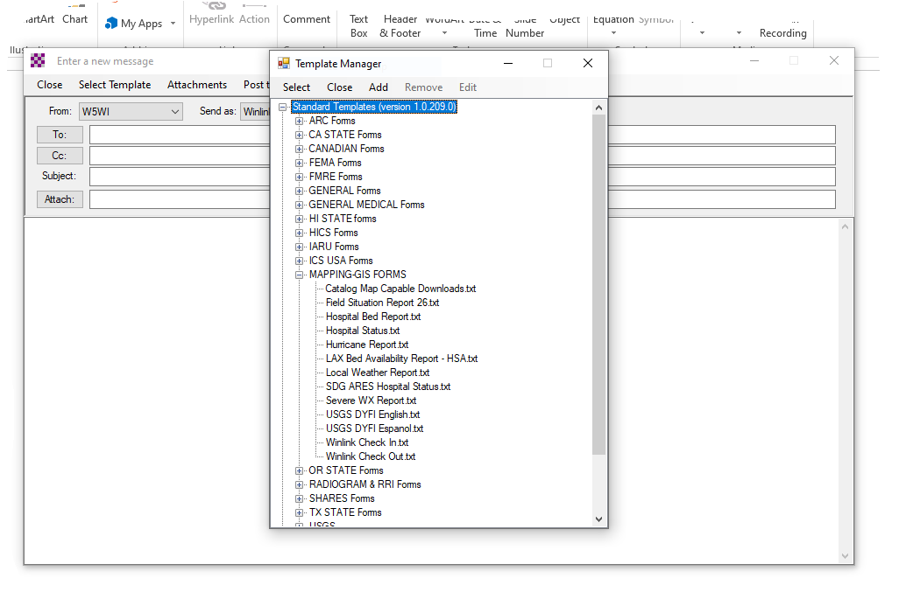
________

Slide 12
